Slide 1
Using Gizmos with Interactive Notebooks
Presented by Charlene Davies
Notes:
Hello everyone, and welcome to ExploreLearning’s webinar on Using Gizmos with Interactive Notebooks. My name is Charlene Davies and I am the Gizmos Specialist in Professional Development for ExploreLearning. I am very excited to share with you a way to use Gizmos to support interactive notebooks in your classroom instruction.

Slide 2
Why Interactive Notebooks?
Helps students organize and synthesize information given to them in class
Allows for creating lessons that involve all of the lobes in the brain
One way for teachers to accommodate all different learning styles
Notes:
Interactive notebooks can serve many purposes in a classroom. They are a great way to have students personalize the content being presented. Because of the way the notebook is set up, which we will cover in this webinar, students are able to retrieve information from their long term memory more effectively. By having students take teacher input, which gets placed on the right side of the notebook, and transform that input into their own creative, unique output on the left side of the notebook allows for learning that involves all lobes of the brain.
Interactive notebooks can be thought of as an organizational tool for lesson planning that accommodates different learning styles of students in a classroom. Teachers can also use interactive notebooks to plan lessons to reach a broad spectrum of intelligences. Overall, interactive notebooks may enhance student learning and can potentially lead to student achievement when executed correctly.

Slide 3
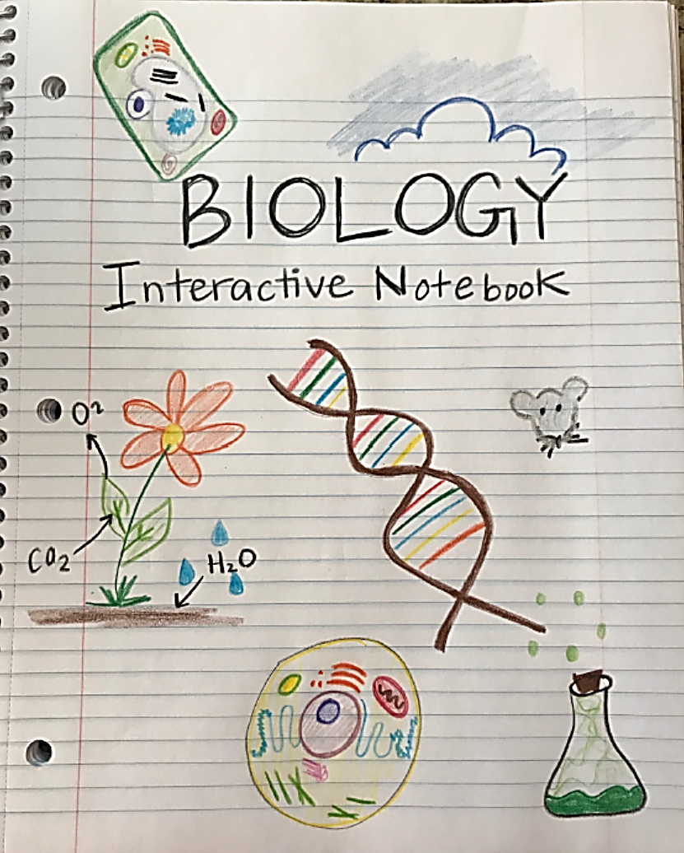
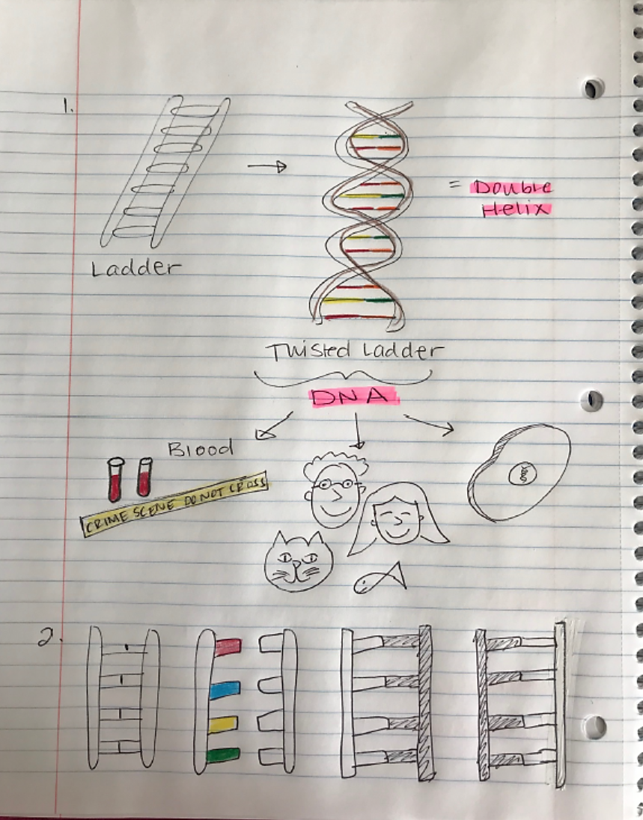
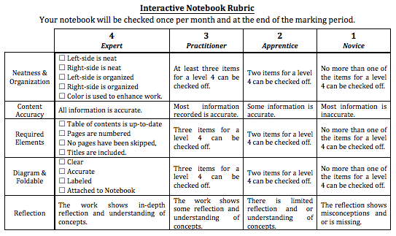
Interactive Notebook Set-Up
Cover Sheet
Notebook Rubric
Name Class and Per. # Teacher Name
1
2
Notes:
Since interactive notebooks are an organizational tool for both the teacher and student, it needs to be structured in such a way that makes sense and is useful, for instance, studying for an upcoming assessment.
Often, interactive notebooks are large and spiral bound. Once students have their notebooks, they should number the pages with odd numbers always going on the right side, and even numbers going on the left side of the notebook.
Page 1 is a title page or cover sheet. Have students decorate this page with symbols and drawings that pertain to what they think they will be studying in the class during the school year.
On the back of cover sheet should go the notebook rubric which is page 2. Print this out and have students tape or glue it into the notebook. If students have access to what is expected of them, there will be no guess work in what grade they will obtain for the notebook.

Slide 4
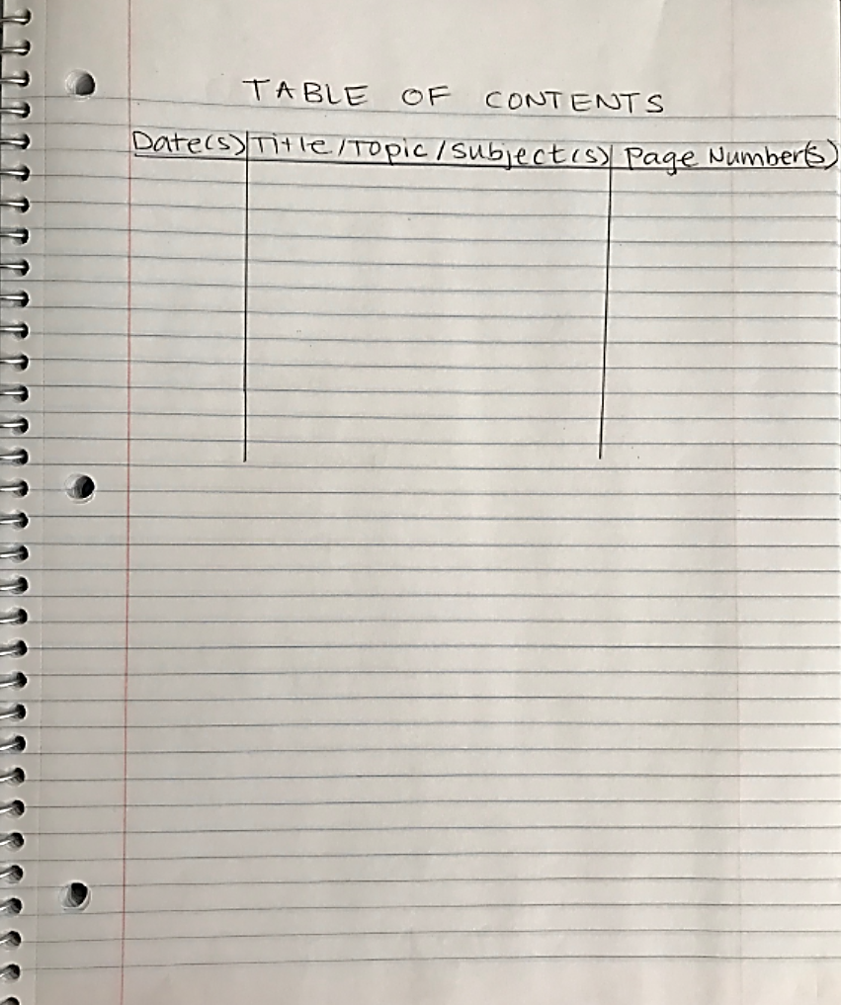
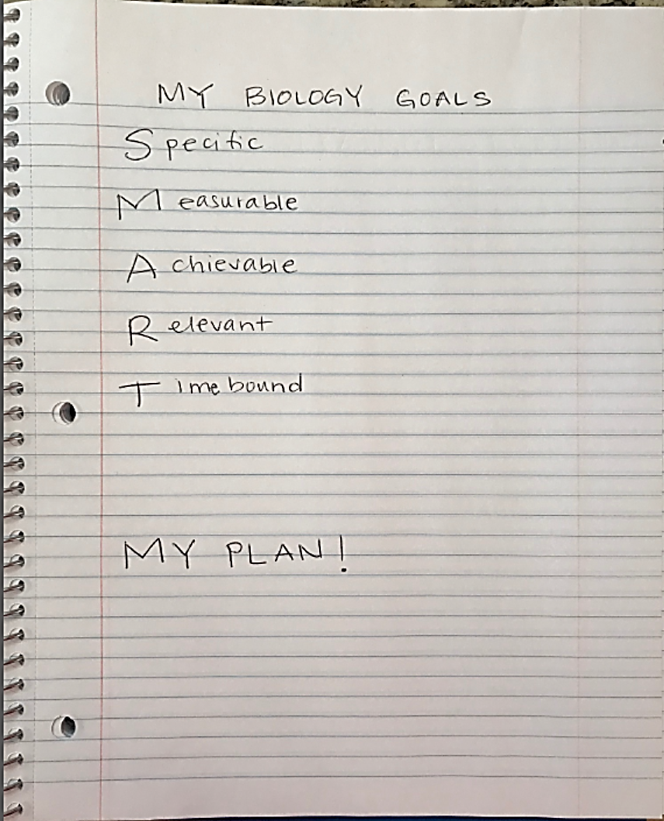
Interactive Notebook Set-Up
Table of Contents
Class Goals and Plan
3
7
Notes:
After the rubric, the table of contents comes next. I have provided an example of what the table of contents could look like. This will provide a reference tool to the student for studying, as well as the teacher for grading. Have students dedicate a few page numbers to the table of contents.
Finally, the next odd number page should be for class goals and plan to achieve them. Students can practice using the SMART goals format and devise a plan to reach these goals for the class during the school year.

Slide 5
Taking Sides
L
Even page numbers
Student output
An opportunity for the student to be as creative as they want!
Notes:
Each pair of pages after the notebook set up is designated for different purposes.
On the left side of the notebook are the even numbers. The even number pages are designated for student output only. This is an opportunity for the student to be as creative as they want with the input!

Slide 6
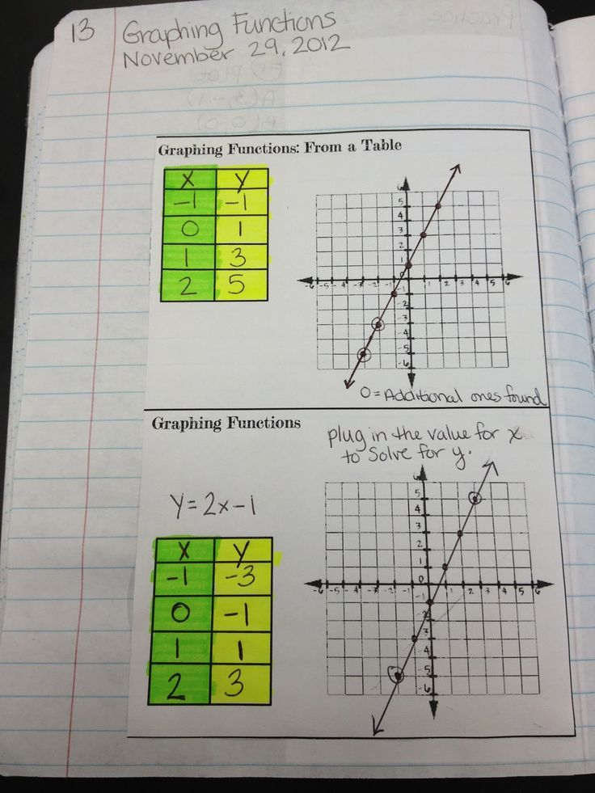
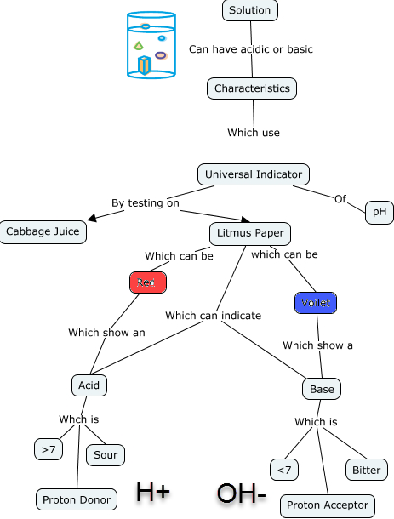
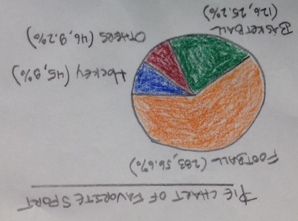
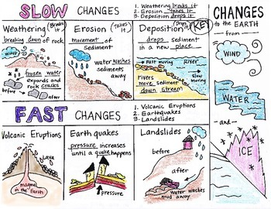
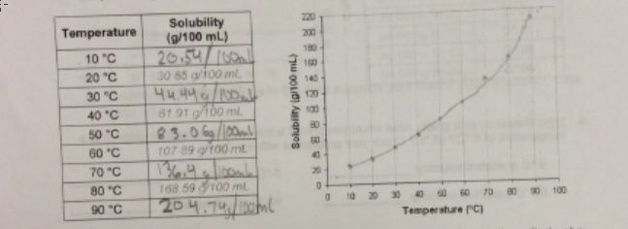
Left Side Examples
Lots of Color
Drawings
Concept Maps
Reflective Writing
Questions
Data and Graphs
Songs and/or Poems
Cartoons
Flow Carts
Metaphors
Analogies
Venn Diagrams
Notes:
The left side should have lots of color, drawings, concept maps…..
Questions that students have about the teacher input or content being covered
As you can see, the left side embraces all different learning styles and multiple intelligences

Slide 7
Taking Sides
R
Odd page numbers
Teacher input
The right side of the notebook contains information given by the teacher
Notes:
On the right side of the notebook are the odd numbers. The odd number pages are designated for teacher input only. It contains information given by the teacher.

Slide 8
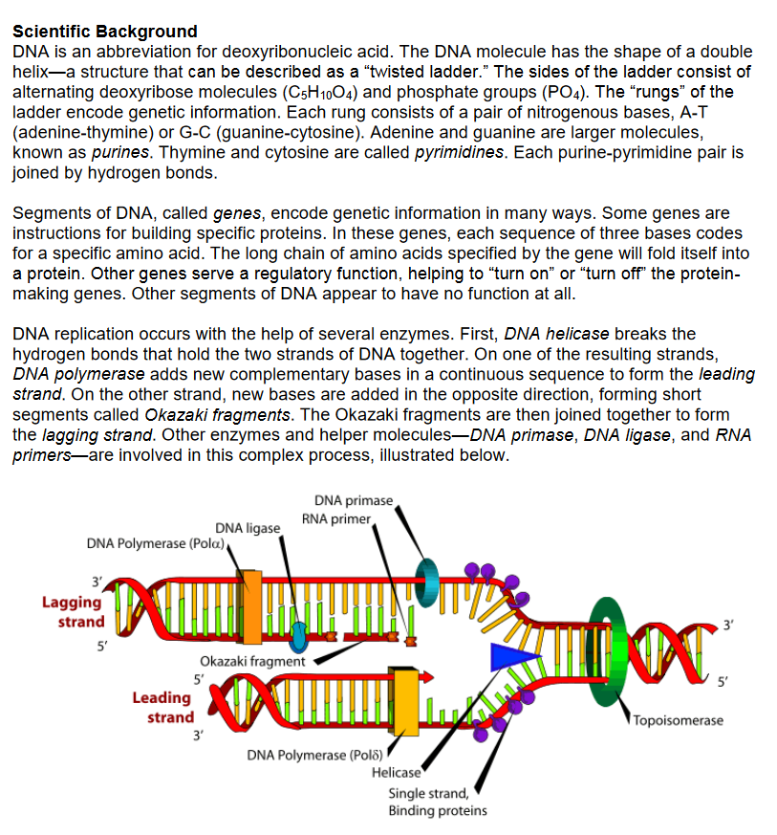
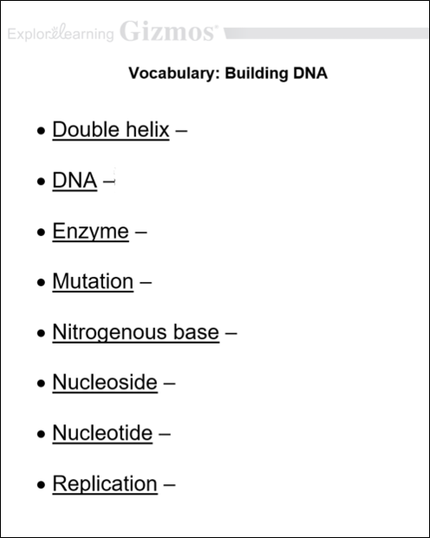
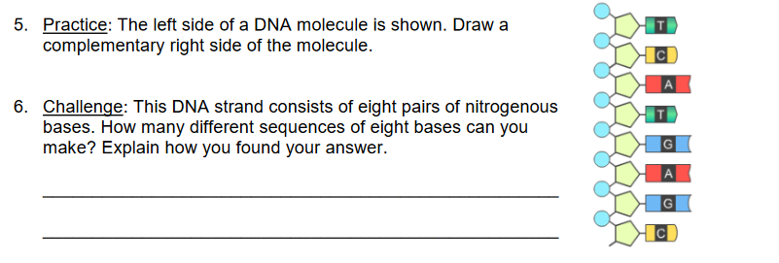
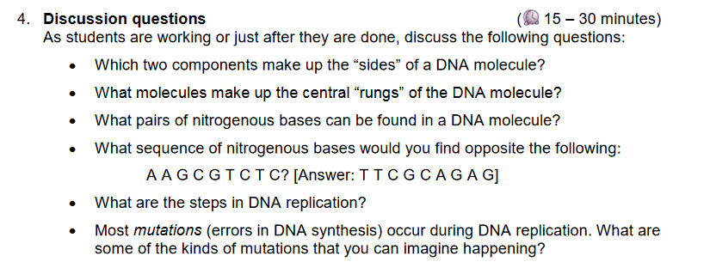
Right Side Examples
Lecture Notes
Lab Notes
Vocabulary
Prior Knowledge Questions
Questions from activities in the Student Exploration Sheet
Discussion questions in the Teacher Guide
Reading Notes
Movie Notes
Study Guides
PowerPoint Notes
Notes:
Many of the right side examples I took from the lesson materials that accompany each ExploreLearning Gizmo.
Each Gizmos has a TG that provides a scientific background tat can be used as lecture notes. Students can paste this in their notebook in the right side, and draw pictures or summarize in their own words on the left side.
All of the lesson materials can be customized. Here, I took the vocabulary sheet in the Gizmo and deleted the definitions. This would go on the right side of the notebook. Students would draw pictures and define in their own words on the left side.
The prior knowledge questions can be used as bell work on the right side, students would answer these questions on the left side.
The discussion questions that can be found in the TG, serve as great exit tickets or seat work.
Reading notes, movie notes, study guides and powerpoint notes would also go on the right side as well.

Slide 9
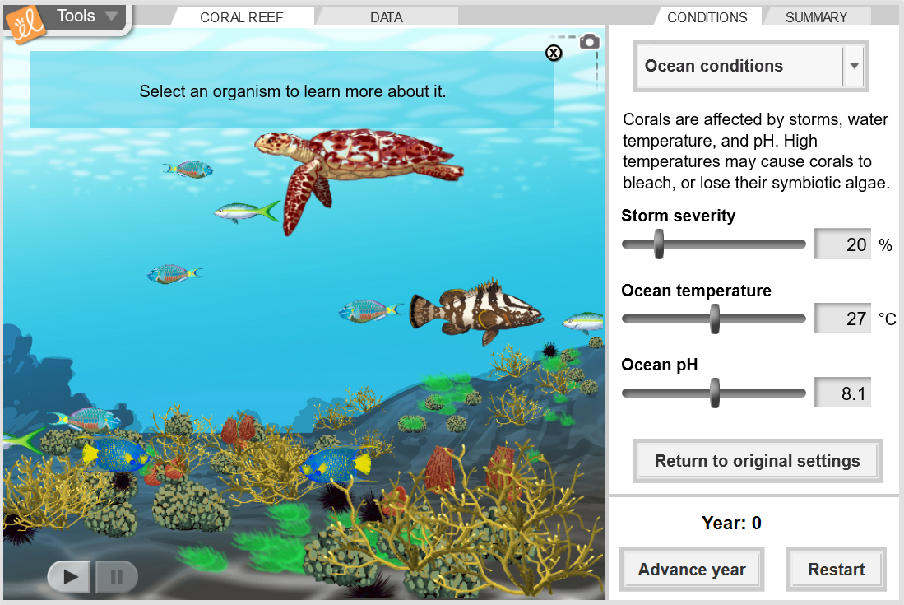
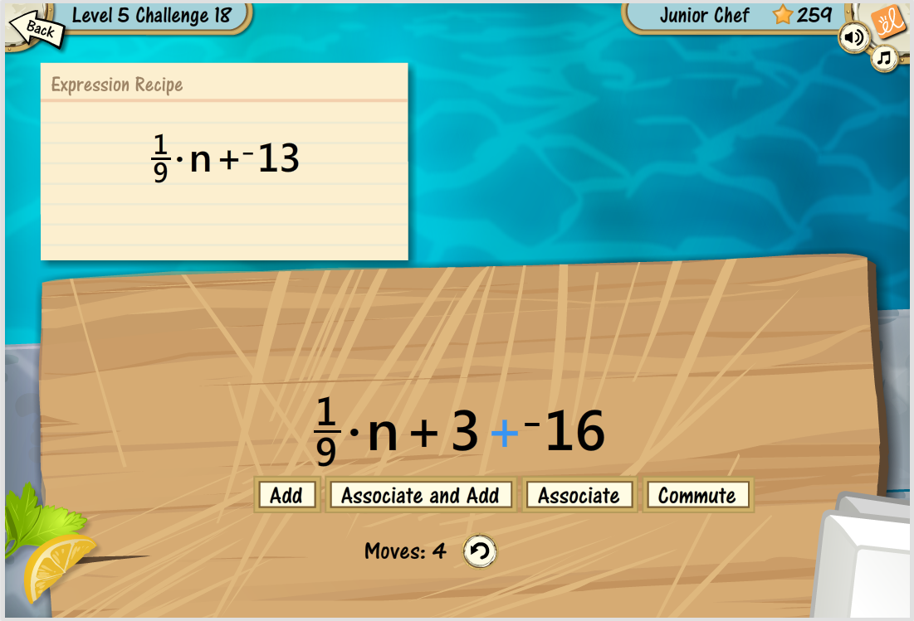
What is an ExploreLearning Gizmo?
An interactive online simulation
For math and science
For students in grades 3-12
A fun way to learn and build lasting knowledge
Notes:
How do we define a Gizmo? Gizmos are highly interactive, online simulations for math and science that cover content from grades 3-12. Gizmos help students gain deeper understanding of math and science concepts. Gizmos are correlated to the NGSS and the latest state standards
They are inquiry-based. Teachers can supplement and enhance instruction with powerful interactive “visualizations” of concepts. Students can manipulate key variables, generate and test hypotheses, and engage in extensive “what-if” experimentation. Gizmos also include lesson materials to help you implement Gizmos effectively into your classroom instruction
Finally, and this is an important point, Gizmos make learning Math and Science FUN!

Slide 10
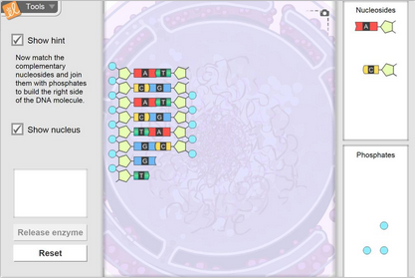
Gizmo: Building DNA
Notes:
Let’s open up the Gizmo: Building DNA and launch it.
In this Gizmo, students can construct a DNA molecule, examine its double-helix structure, and then go through the DNA replication process. This Gizmo helps students learn how each component fits into a DNA molecule, and see how a unique, self-replicating code can be created.
Follow the steps given in the Gizmo to construct a molecule of DNA. The hint box can be clicked on to help facilitate the construction of the DNA molecule. The snap shot tool in the upper right hand corner allows us to take a picture of the molecule, paste it into a word doc or google doc and potentially print the molecule for the interactive notebook.
Keep working through Gizmo…
Go through lesson materials.

Slide 11
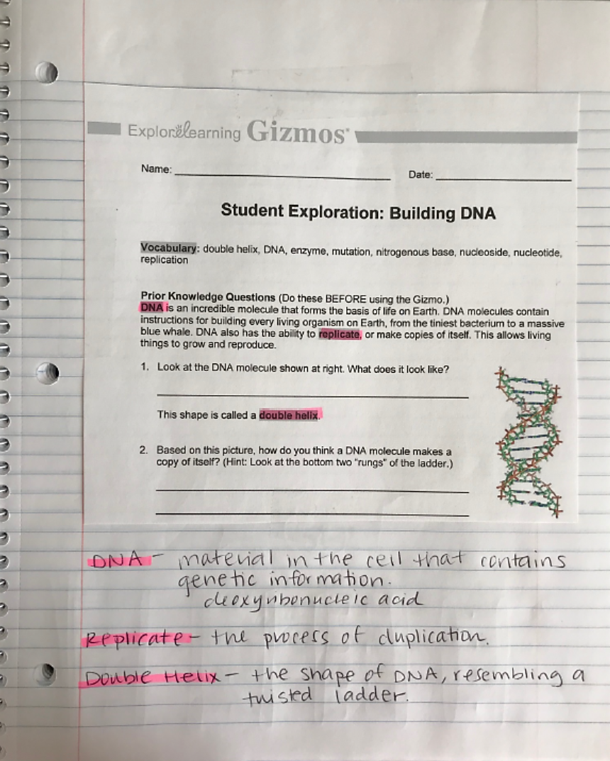
Gizmo: Building DNA
8
9
Notes:
This is an example of using the prior knowledge questions in the SE sheet as a bell ringer. As you can see, the prior knowledge questions were pasted on the right hand side of the notebook as these would be question that teacher would give the student to answer. Students can also write these questions down. In the lesson materials, all key vocabulary is highlighted gray. The student can also use the right side to start defining these key vocabulary words or take additional notes.
On the left side, the student answers the questions by using color, pictures, symbols, and labels.

Slide 12
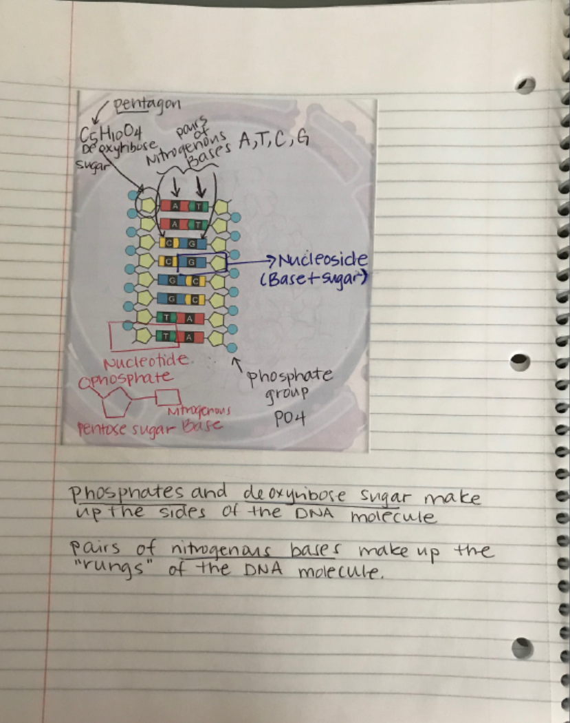
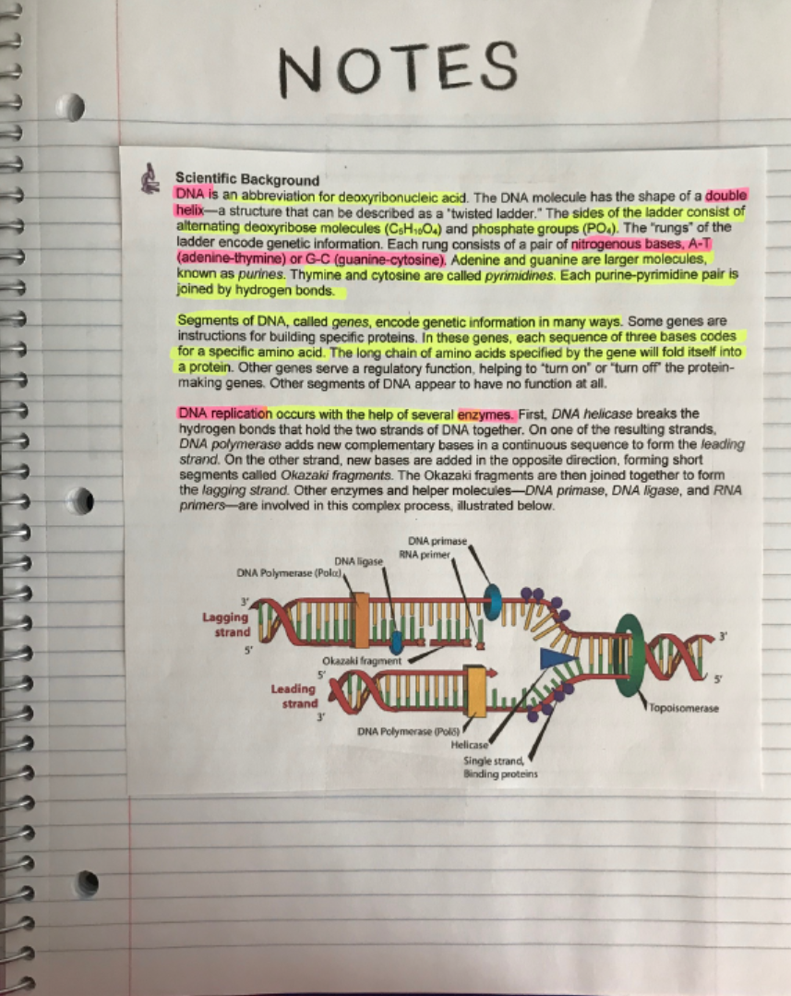
Gizmo: Building DNA
10
11
Notes:
Here is an example of taking the scientific background provided in the TG and using this as lecture notes.
On the left side, the snap shot tool was used to take a picture of the constructed DNA molecule.

Slide 13
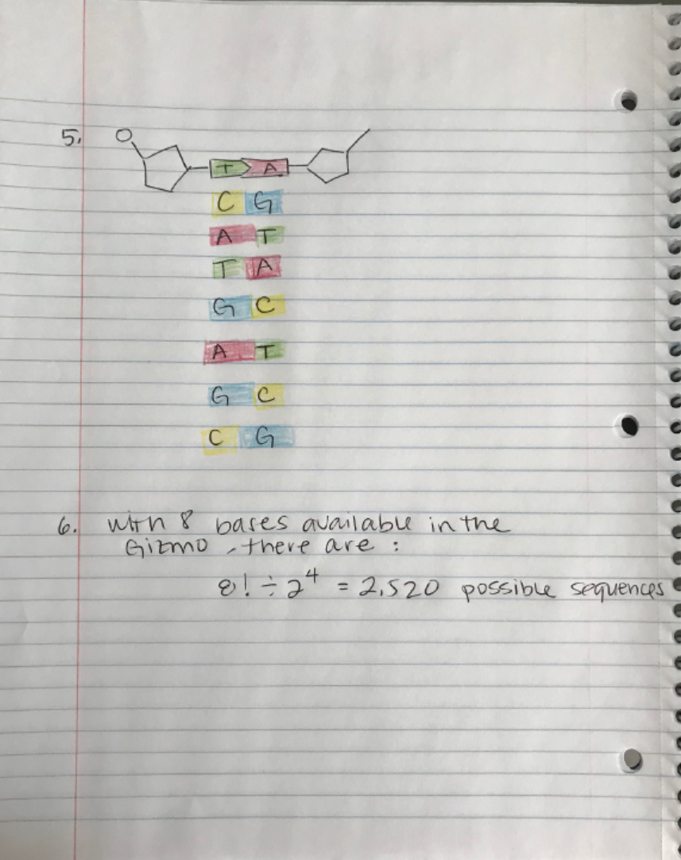
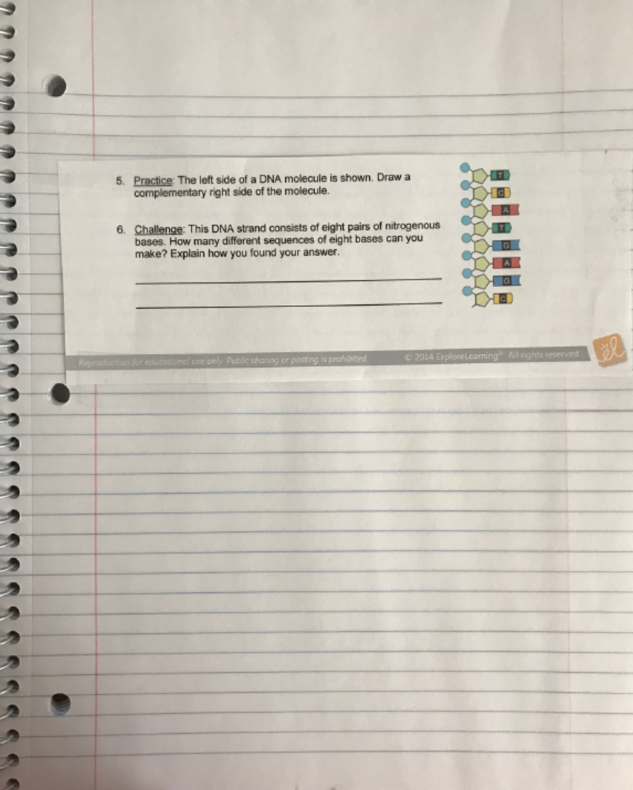
Gizmo: Building DNA
12
13
Notes:
Each activity in the student exploration sheet provide a wealth of questions that can be written or taped on the right side. Students will answer those questions on the left side of the notebook.

Slide 14
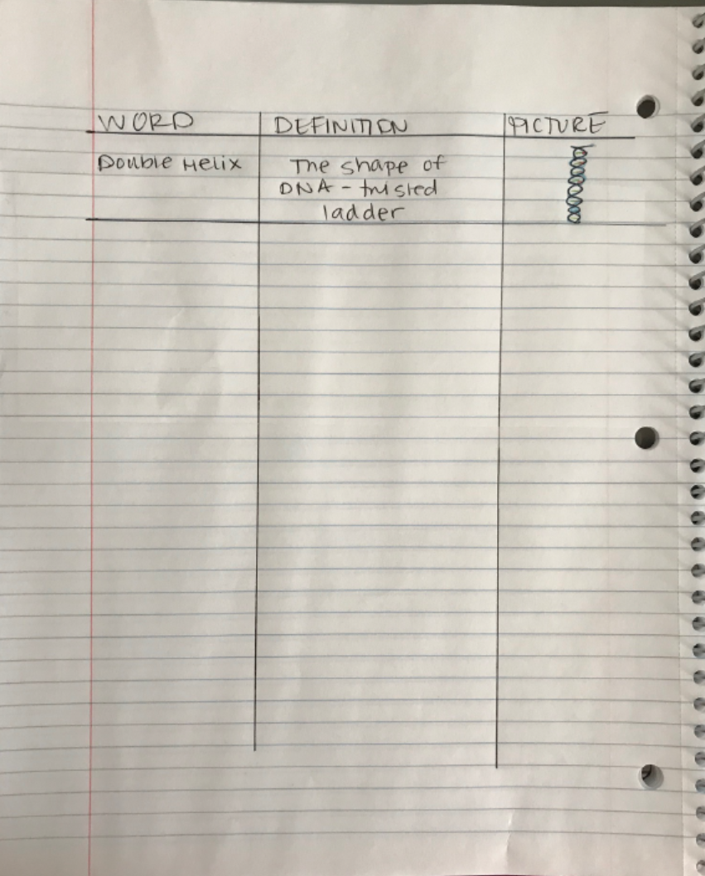
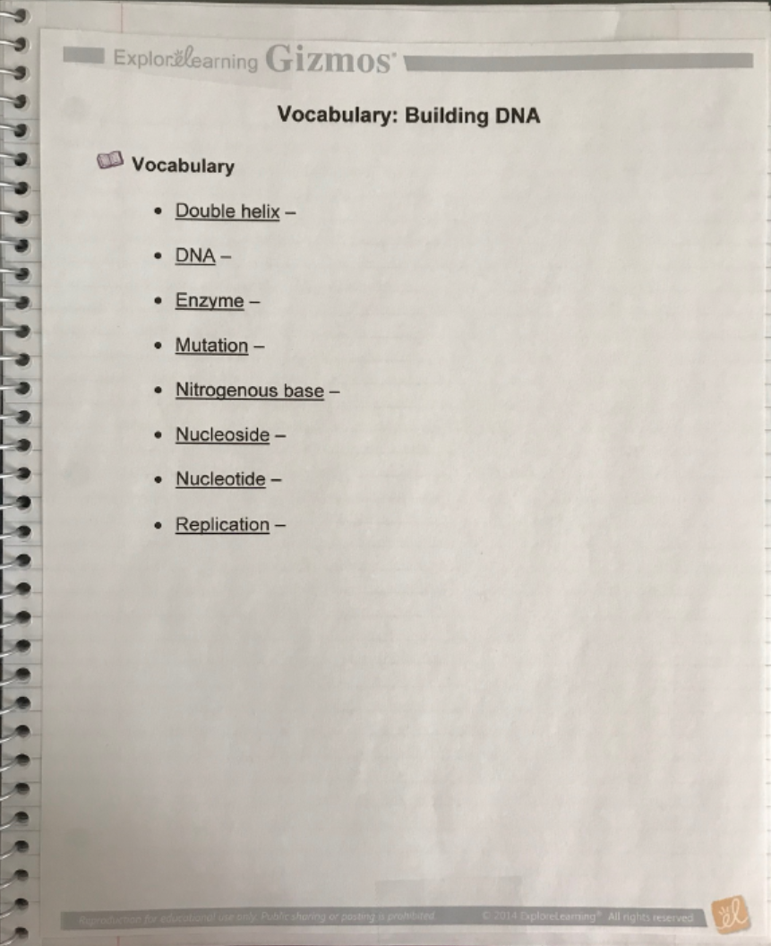
Gizmo: Building DNA
14
15
Notes:
Customizing the vocabulary sheet by deleting the definitions provides a list of key words for the unit. Students can provide the definition in their own words, as well as a picture.

Slide 15
Gizmos and Interactive Notebooks: A Great Match-Up
A Gizmo gives students great examples of what to draw in their notebook. Students use a lot of the things that they’ve seen in the Gizmo because it’s a very visual thing that they’ve experienced and very hands-on for them. They’re able to use it and put it into their interactive notebooks so they’re able to explain their thinking better. The teacher can use the notebooks as a way to see whether the students are getting the content or not. The teacher uses the notebook to check for understanding as a kind of formative assessment along the way.
Lesley Gates, District Science Coach, Kings Canyon USD, CA
Notes:
Kings Canyon Unified School District, a CA NGSS K-8 Early Implementation Initiative district, are using Gizmos to help ease the transition to the NGSS integrated model for middle school. Lesley Gates, District Science Coach, mentions that a Gizmo gives students great examples of what to draw in their notebook. Because Gizmos are visual and hands-on, it allows the students to explain their thinking better which is easily transcribed or copied into the notebook.
In summary, interactive notebooks are a great way to check for understanding, organize the learning process, and helps the brain make connections between what is learned and what that information means to the learned. Gizmos supports this learning tool by provided lesson materials that are a perfect match for teacher input and student output.

Slide 16
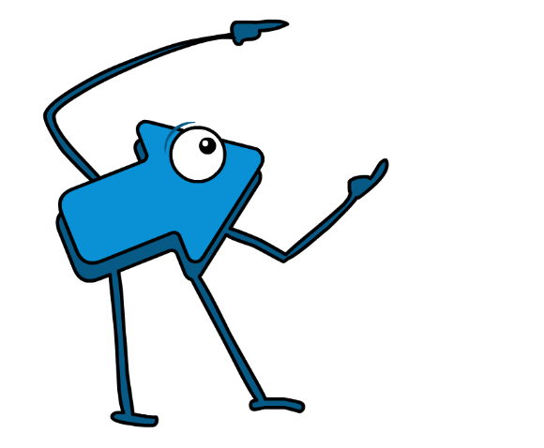
Next steps: Get started with a Free Account!
Use a rotating, curated collection of 20-40 free Gizmos
Preview the other 400+ Gizmos for up to 5 minutes a day
Free Gizmos change each semester
Includes teacher guides, lesson plans, and more
www.explorelearning.com/free
Notes:
—This is an on-click animation—
Try out Gizmos for yourself with our free account. It includes:
Access to a rotating, curated collection of 20-40 Gizmos that cover a variety of topics and grades
The ability to preview our 400-plus other Gizmos for up to five minutes a day
Teacher guides, lesson plans, and more
The free Gizmos change each semester
Sign up today at our site explorelearning.com/free

Slide 17
Contact me
Charlene Davies
charlene.davies@explorelearning.com
866-882-4141 x2405
www.explorelearning.com
Notes:
Thank you so much for listening to Using Gizmos with Interactive Notebooks webinar. I hope you were able to take away some ideas on how to use gizmos to support his highly effective learning tool.
Once again, my name is Charlene Davies and you can contact me with any questions or ideas you have on using Gizmos to support classroom instruction.
Have fun with your free Gizmos account!

